Slide 1
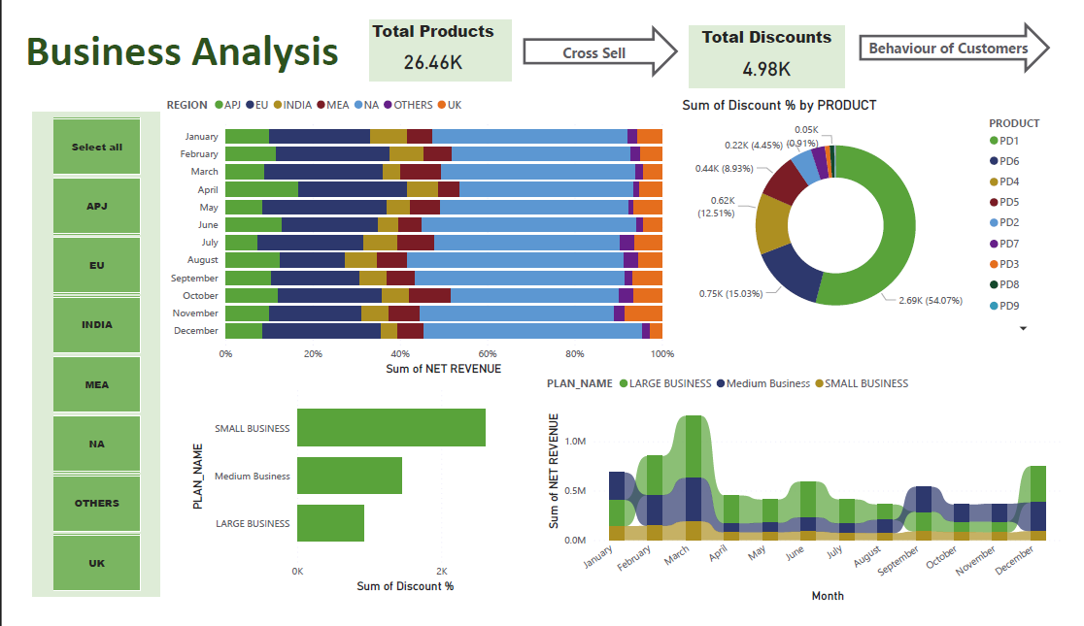

Slide 2
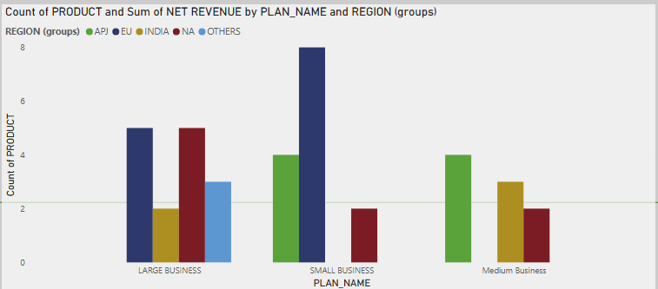

Slide 3
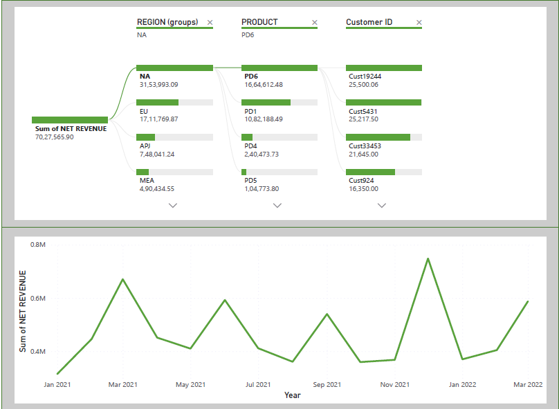

Slide 4
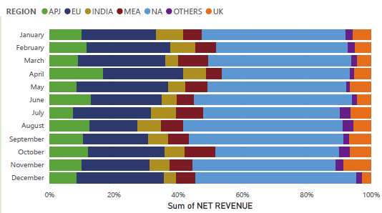
Which region has performed well in terms of net revenue across Months? North America has performed well in terms of net revenue across Months

Slide 5
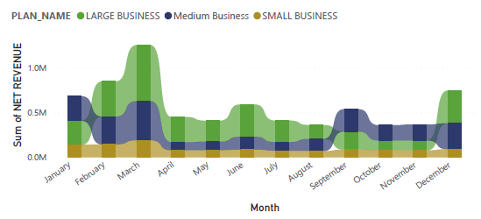
What plans are preferred by the customers across months Across the month, average cost spending by customers to buy from large business products

Slide 6
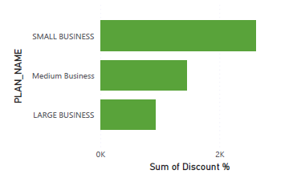
Do Higher plans correlate with higher discount%? No, Small business providing much discouhts to customers.

Slide 7
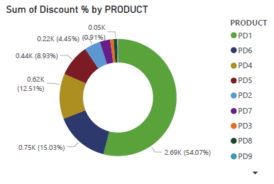
How is the discount varying between different products? All products has different discounts provided by the teams. PD1 has the high discount product given

Slide 8
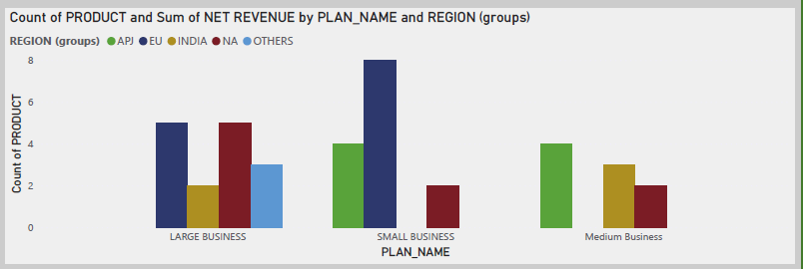
Which team sells more cross sell in terms of revenue achieved by the region? Small Business sells more cross sell in Europian union region

Slide 9
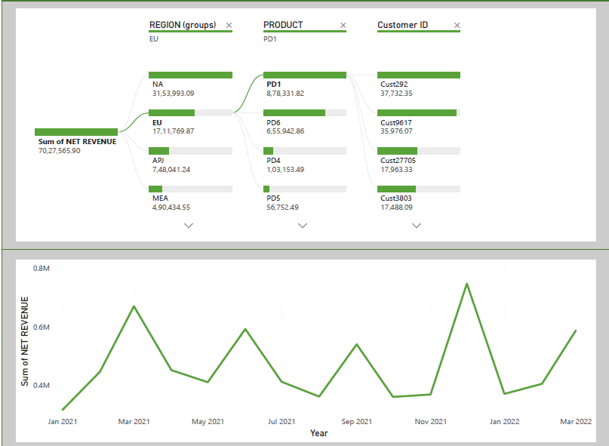
Create 2 metrics (with visualizations) that can be utilized to track the behavior of the customers

